Slide 1
Evaluator Instructions (Test Set)
Your task: You will review 15 analysis outputs. For each output, assign 0–3 ratings for the listed metrics based on the provided definitions and the dataset description.
Use the prompt + dataset card + shown results to judge whether choices are reasonable.
Analyses variants can be very similar, this is acceptable
Don’t evaluate quality of the log’s appearance (family/type, filters, […]), just evaluate the information in the log
Don’t focus on formatting or language details (except when it’s relevant to the quality, e.g. value range for axis or outlier handling).
If a step (e.g. aggregation) is not needed, it is correct to keep it blank (“none”)
Sometimes filter decisions make sense, even though they weren’t requested in the prompt, that’s the right choice and leads to the highest score
Assume plots are technically correct if the stated processing decisions are plausible.
Annotator ID (or name/pseudonym): 2
Field / Discipline (e.g., Computer Science): Computer Science
Qualification / Role (closest match; e.g., Data Science student, BSc in Data Science, BI manager): Computer Science Student
Gender: Female
Age: 24
Please complete these information

Slide 2
Explanation of the experimental design
Meaning of Evaluation Metrics
perceived_analysis_difficulty: How hard the prompt itself feels (ambiguity, elements to take into account, analysis complexity).
task_choice_quality: How appropriate the chosen analysis family/type is for the prompt (descriptive [What is happening?], diagnostic [Why is it happening?], predictive [What will happen?], prescriptive [What should we do?] and the respective analysis type of each category).
data_scope_quality: How reasonable the filters + column choices together are, given the prompt and dataset card.
prep_and_aggregation_quality: How appropriate the prep steps and aggregations are.
summary_quality: Does the written summary faithfully reflect the plots/numbers and/or add useful information?
visualization_helpfulness: Do the plots materially help to understand the answer? Does it cover the whole requested analysis?
analysis_request_fulfilment: Overall, if you were the person asking this question, does this output feel like it fulfils the analysis request?
Evaluation scale (0-3)
0 – Poor: Clearly wrong / off; would mislead a stakeholder.
1 – Weak: Partly reasonable but with major issues or gaps.
2 – OK: Mostly reasonable; only minor issues that don’t change the main takeaway.
3 – Strong: Clearly appropriate and high-quality; no substantive issues.

Slide 3
Explanation of the dataset
Short description of the data (domain view)
General context: The data describes production operations in a manufacturing environment. Each row represents a single operation (e.g., drilling, milling) within a production order. A production order can consist of multiple operations. The data includes planned dates, actual dates, cycle times and various schedule deviations (TA).
Field definitions
pps_order_id: Unique ID of a production order
pps_order_pos_id: Unique ID of the operation within the order (one order consists of multiple operations)
resource_group: Operations are executed on specific machine groups / resource groups (e.g., CNC milling, drilling machines)
plan_start: Planned operation start (date, day-level granularity)
ist_start: Actual start (date, day-level granularity)
plan_ende: Planned end (date, day-level granularity)
ist_ende: Actual end (date, day-level granularity) (if available)
status: Operation status (e.g., “in progress”, “finished”)
avg_type: Operation type (drilling, milling, assembly, etc.), more specific than resource_group
ist_dlz: Cycle time / Lead time (in days), computed as ist_ende minus ist_start
ta_zugang: Start schedule deviation (TA for Terminabweichung) (in days), computed as ist_start − plan_start; positive = start occurred later than planned
ta_abgang: End schedule deviation (TA for Terminabweichung) (in days), computed as ist_ende − plan_ende; positive = end occurred later than planned
ta_rel: Lead-time (or cycle time) deviation (in days) from planned to actual lead time, computed as ta_abgang − ta_zugang; positive = lead time was longer than planned
ta_status: Indicates whether the operation ran with schedule deviation (“mit TA”) or without schedule deviation (“ohne TA”)
Dataset summary (rows/cols, uniques, ranges, missingness)
Dataset (complete): 14 columns, 19887 rows
pps_order_id: 5629 unique values (order id)
pps_order_pos_id: Typically values such as 10, 20, 30 and so on, representing the sub ids within one order
resource_group: 21 categories, most common are “Fräsen Gruppe Kleinteile” (2837), “Sägen” (2463), “Montage” (2317) and “Schleifen-Gruppe” (2036)
plan_start: earliest date on 18th of December 2023 and latest date on 30th of April 2025
ist_start: earliest date on 12th of August 2023 and latest date on 14th of May 2025
plan_ende: earliest date on 1st of May 2024 and latest date on 30th of April 2025
ist_ende: earliest date on 13th of August 2023 and latest date on 16th of April 2025, 723 missing values due to unfinished operations
status: 2 categories, fertiggemeldet (19164), laufend (723)
avg_type: 159 categories, most common are “Rohmaterial auf Länge sägen“ (2357), „Kleinbauteile schlichten“ (1883), „Funktionsprüfung“ (1882), „Profilschleifen“ (1702)
ist_dlz: all values between 0 and 36, but typically 1 day, 723 missing values due to unfinished operations
ta_zugang: values typically between -15 and 3 days, but some big outliers, median at -2 days
ta_abgang: values typically between -18 and 1 days, but some big outliers, median at -4 days, 723 missing values due to unfinished operations
ta_rel: values typically between -3 and 0 days, but some big outliers, median at -1 day, 723 missing values due to unfinished operations
ta_status: 3 categories, “ohne TA“ (meaning: everything on time) (13670), „mit TA“ (meaning: something not on time) (5494), „TA nicht erreichbar“ (meaning: operation still running and already something late) (723)

Slide 4
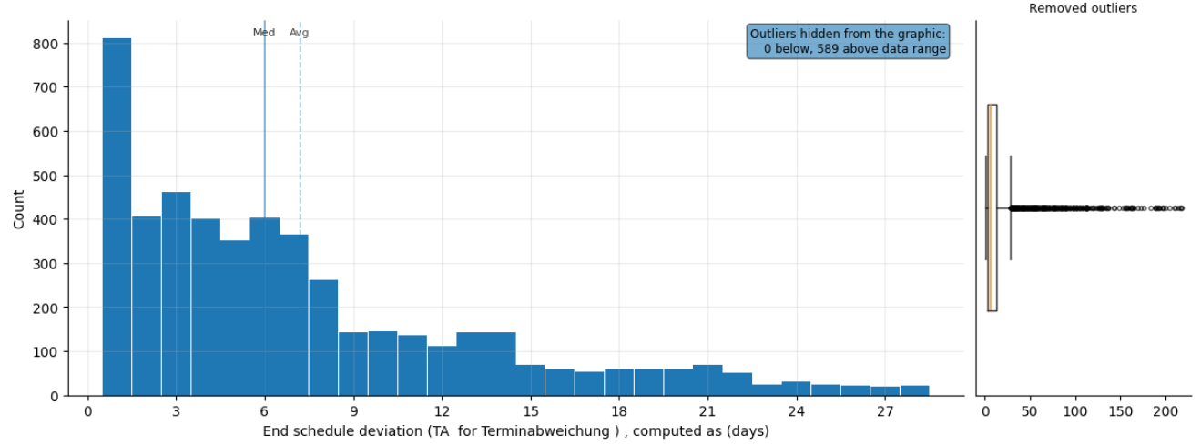
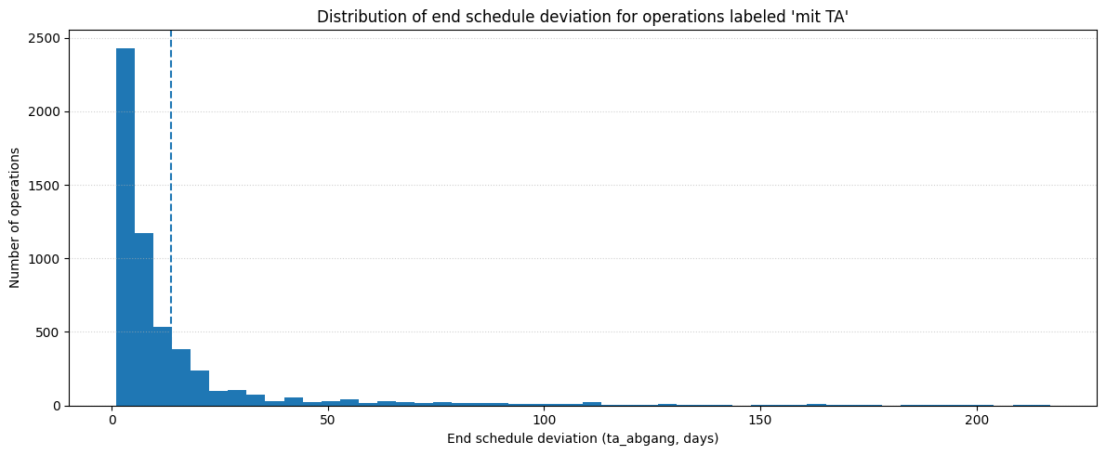
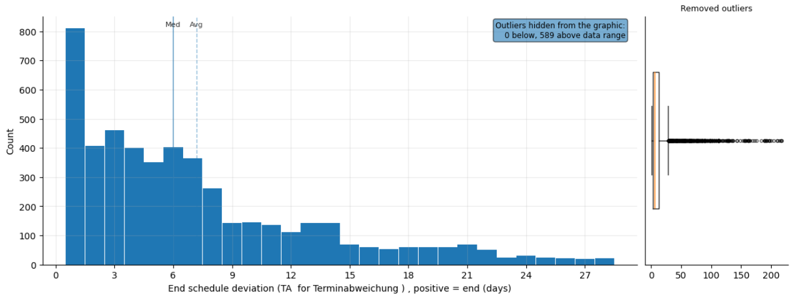
Prompt 1: Show the distribution of end schedule deviation for operations labeled “mit TA”.
Metric / Analysis | Evaluation (0 to 3)
Family/type: descriptive, distribution
Filters: ta_status == mit TA
Columns: ta_abgang
Prepare: none
Aggregate: none
Verify status: warn (check summary)
Summary: Operations with schedule deviation finish on average 14 days late. Delays are typically between 1 and 57 days, with extremes up to 217 days. Identify causes for the extreme delays.
perceived_analysis_difficulty | 1
task_choice_quality | 3
data_scope_quality | 3
prep_and_aggregation_quality | 3
summary_quality | 2
visualization_helpfulness | 3
analysis_request_fulfilment | 3
Family/type: descriptive, distribution
Filters: ta_status == mit TA
Columns: ta_abgang
Prepare: Remove rows with missing required values (ta_abgang)
Aggregate: none
Verify status: warn (check summary)
Summary: Operations with schedule deviation finish on average about 13.7 days late. Typical delays range from 1 to around 31 days, with extremes from 1 up to 217 days. Strong right-skewed distribution.
perceived_analysis_difficulty | 1
task_choice_quality | 2
data_scope_quality | 3
prep_and_aggregation_quality | 3
summary_quality | 2
visualization_helpfulness | 1
analysis_request_fulfilment | 2
Family/type: descriptive, distribution
Filters: ta_status == mit TA
Columns: ta_abgang
Prepare: none
Aggregate: none
Verify status: warn (check summary)
Summary: Computed distribution of ta_abgang (days): n=5494, mean≈13.70, range≈[1.00, 217.00].
perceived_analysis_difficulty | 1
task_choice_quality | 3
data_scope_quality | 3
prep_and_aggregation_quality | 3
summary_quality | 1
visualization_helpfulness | 3
analysis_request_fulfilment | 2

Slide 5
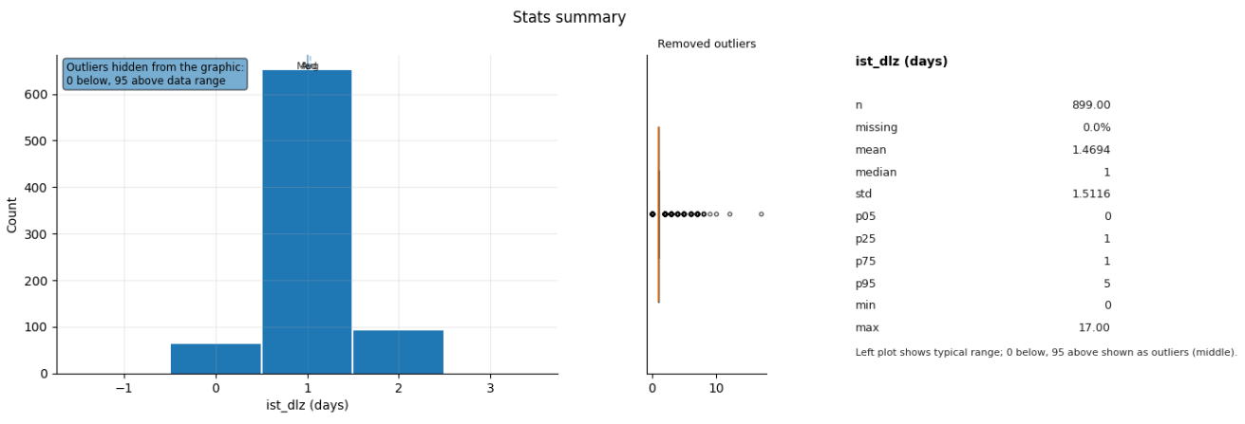
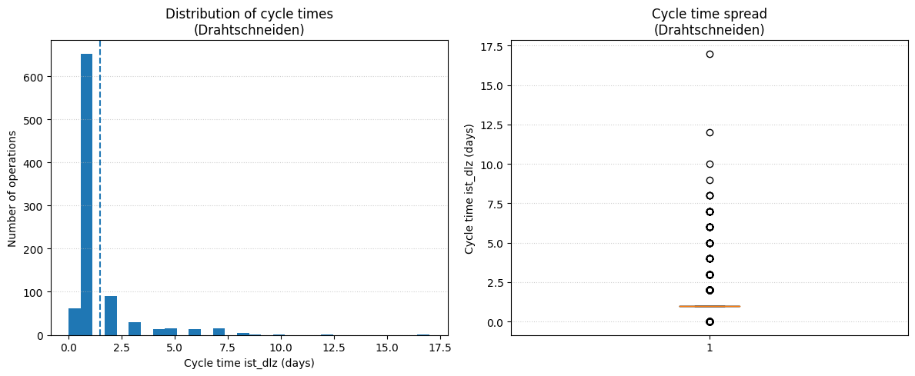

Prompt 2: Show me a statistical summary of the cycle times for ressource group Drahtschneiden.
Metric / Analysis | Evaluation (0 to 3)
Family/type: descriptive, stats summary
Filters: resource_group == Drahtschneiden
Columns: ist_dlz
Prepare: actions: Remove rows with missing required values (ist_dlz)
Aggregate: none
Verify status: warn (check summary)
Summary: Drahtschneiden operations take on average 1.5 days, typically between 0 and 5 days, with some up to 17 days. Validate outlier cycle time entries.
perceived_analysis_difficulty | 2
task_choice_quality | 3
data_scope_quality | 3
prep_and_aggregation_quality | 3
summary_quality | 3
visualization_helpfulness | 3
analysis_request_fulfilment | 3
Family/type: descriptive, summary Filters: resource_group == Drahtschneiden Columns: ist_dlz Prepare: Drop rows with missing ist_dlz Aggregate: summary stats Verify status: warn
Summary: Wire cutting operations have a mean cycle time of 1.47 days and median 1 day, with most between 1 and 3 days and extremes from 0 to 17 days.
perceived_analysis_difficulty | 2
task_choice_quality | 3
data_scope_quality | 2
prep_and_aggregation_quality | 3
summary_quality | 3
visualization_helpfulness | 3
analysis_request_fulfilment | 3
Family/type: descriptive, stats summary
Filters: resource_group == Drahtschneiden
Columns: ist_dlz
Prepare: Standardize missing-value labels; Clean up text (trim spaces)
Aggregate: none
Verify status: ok
Summary: Generated analysis for: Show me a statistical summary of the cycle times for ressource group Drahtschneiden.
perceived_analysis_difficulty | 2
task_choice_quality | 3
data_scope_quality | 3
prep_and_aggregation_quality | 3
summary_quality | 0
visualization_helpfulness | 2
analysis_request_fulfilment | 3

Slide 6
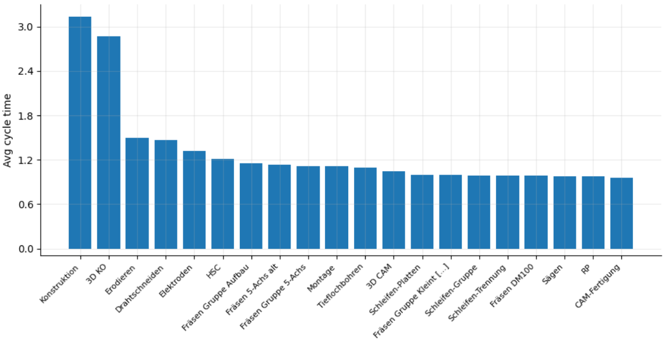
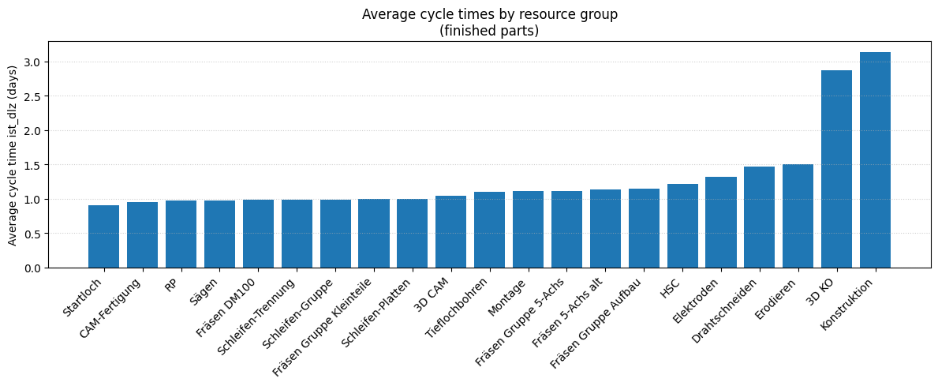
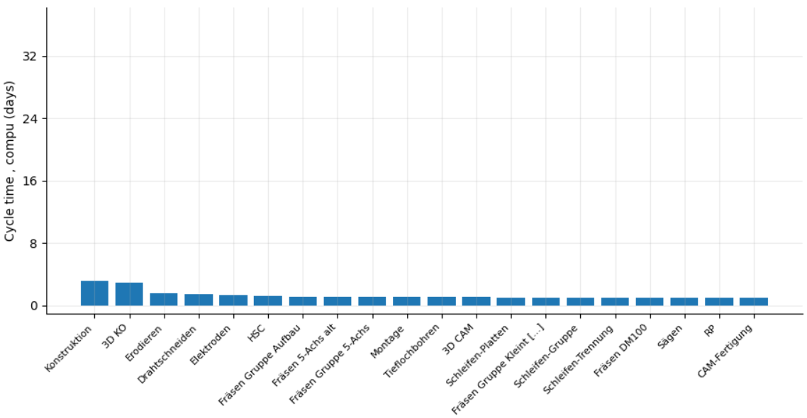
Prompt 3: What are average cycle times by ressource group for finished parts?
Metric / Analysis | Evaluation (0 to 3)
Family/type: descriptive, group compare
Filters: status == fertiggemeldet
Columns: resource_group, ist_dlz
Prepare: Standardize missing-value labels; Clean up text (trim spaces); Convert to numbers (ist_dlz)
Aggregate: groupby=[resource_group]; metrics=[avg_cycle_time(mean:ist_dlz), n_records=count]
Verify status: warn (check summary)
Summary: Average cycle times for finished parts range from about 0.9 to 3.1 days across resource groups. Most groups complete in 1–2 days, with an overall average of 1.28 days. Review slowest groups for process improvements.
perceived_analysis_difficulty | 1
task_choice_quality | 3
data_scope_quality | 3
prep_and_aggregation_quality | 3
summary_quality | 2
visualization_helpfulness | 3
analysis_request_fulfilment | 3
Family/type: descriptive, summary Filters: ist_ende not missing Columns: ist_dlz, resource_group Prepare: Drop rows with missing ist_dlz or resource_group Aggregate: mean(ist_dlz) by resource_group Verify status: warn (check summary)
Summary: Average cycle times by resource group range from about 0.9 to 3.1 days; most production groups lie around 1–1.5 days, while 3D KO and Konstruktion show the longest averages.
perceived_analysis_difficulty | 1
task_choice_quality | 2
data_scope_quality | 3
prep_and_aggregation_quality | 3
summary_quality | 3
visualization_helpfulness | 3
analysis_request_fulfilment | 3
Family/type: descriptive, group compare
Filters: status == fertiggemeldet
Columns: resource_group, ist_dlz
Prepare: none
Aggregate: none
Verify status: warn
Summary: Generated analysis for: What are average cycle times by ressource group for finished parts?.
perceived_analysis_difficulty | 1
task_choice_quality | 1
data_scope_quality | 3
prep_and_aggregation_quality | 1
summary_quality | 0
visualization_helpfulness | 1
analysis_request_fulfilment | 0

Slide 7
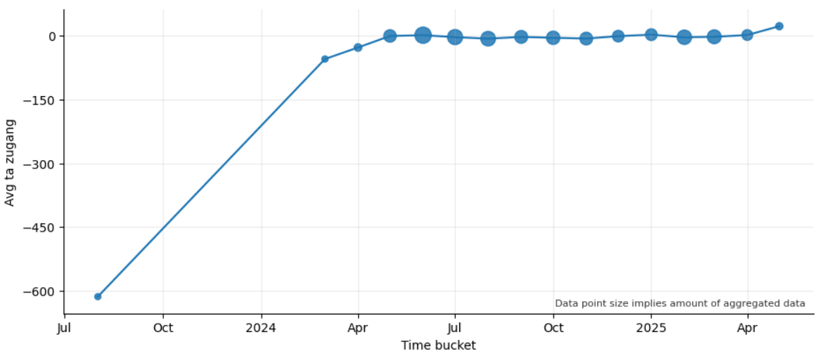
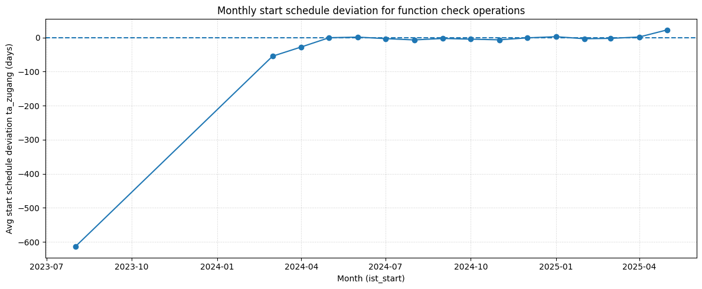
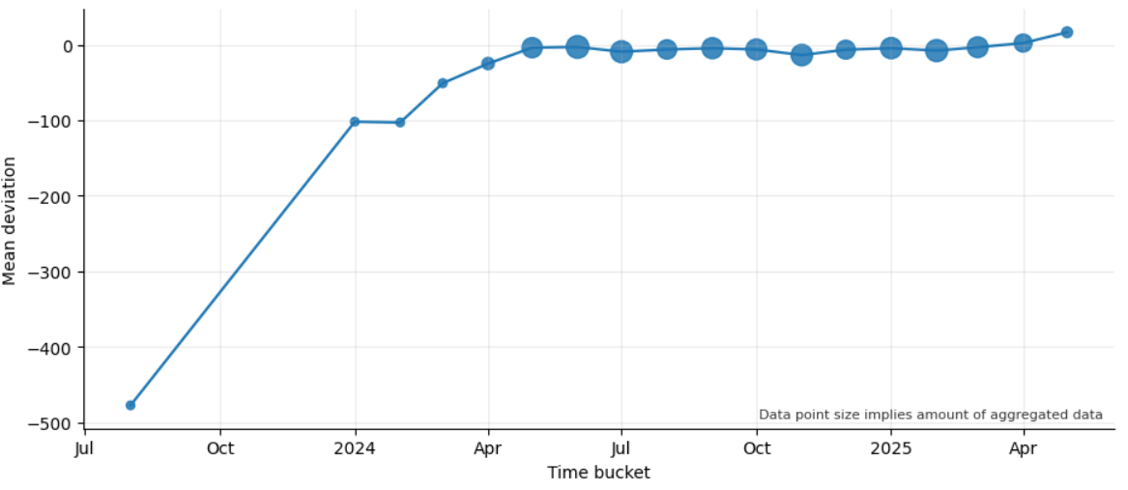
Prompt 4: Over time, how is monthly start schedule deviation developing for function check operations?
Metric / Analysis | Evaluation (0 to 3)
Family/type: descriptive, trend
Filters: avg_type == Funktionsprüfung
Columns: ist_start, ta_zugang
Prepare: none
Aggregate: time=ist_start/month; metrics=[avg_ta_zugang(mean:ta_zugang), n_records=count]
Verify status: warn (check summary)
Summary: Monthly start deviations rose from about 614 days early to about 22 days late. Now most months start between about 3 days early and 8 days late. Aug 2023 average based on only 1 record.
perceived_analysis_difficulty | 1
task_choice_quality | 1
data_scope_quality | 3
prep_and_aggregation_quality | 3
summary_quality | 3
visualization_helpfulness | 2
analysis_request_fulfilment | 3
Family/type: descriptive, trend Filters: avg_type == Funktionsprüfung; ta_zugang not missing; ist_start not missing Columns: ta_zugang, ist_start Prepare: Derive month from ist_start; drop missing values Aggregate: mean(ta_zugang) by month Verify status: warn (check summary)
Summary: Start deviation for function checks strongly improves from very early starts (≈ −600 to −50 days) in early periods towards values close to plan around mid-2024, then fluctuates mildly around 0 days with a recent shift to late starts of roughly +20 days.
perceived_analysis_difficulty | 1
task_choice_quality | 2
data_scope_quality | 3
prep_and_aggregation_quality | 3
summary_quality | 3
visualization_helpfulness | 2
analysis_request_fulfilment | 3
Family/type: descriptive, trend
Filters: none
Columns: ist_start, ta_zugang
Prepare: none
Aggregate: time=ist_start/month; metrics=[mean_deviation(mean:ta_zugang), n_records=count]
Verify status: warn
Summary: Computed monthly average mean_deviation by group (2023-08-01T00:00:00 → 2025-05-01T00:00:00, 18 points; mean≈-45.01; Δend-start≈493.88).
perceived_analysis_difficulty | 1
task_choice_quality | 2
data_scope_quality | 1
prep_and_aggregation_quality | 3
summary_quality | 0
visualization_helpfulness | 2
analysis_request_fulfilment | 1

Slide 8
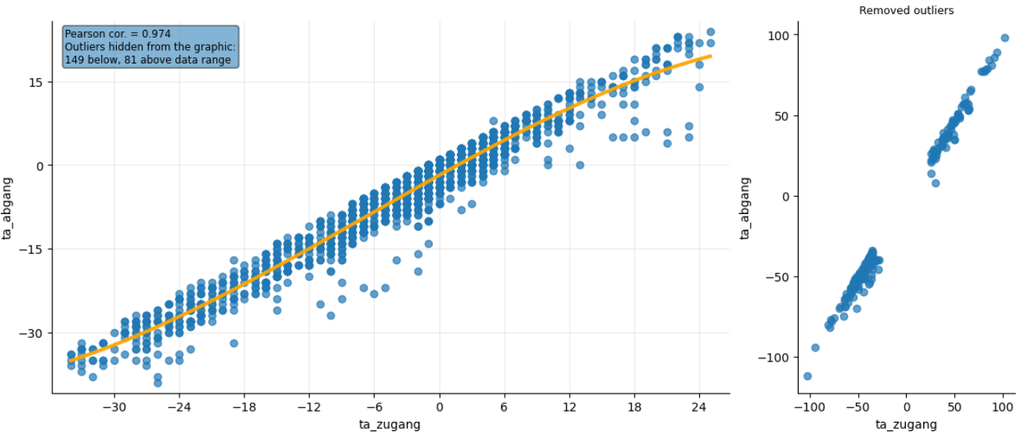
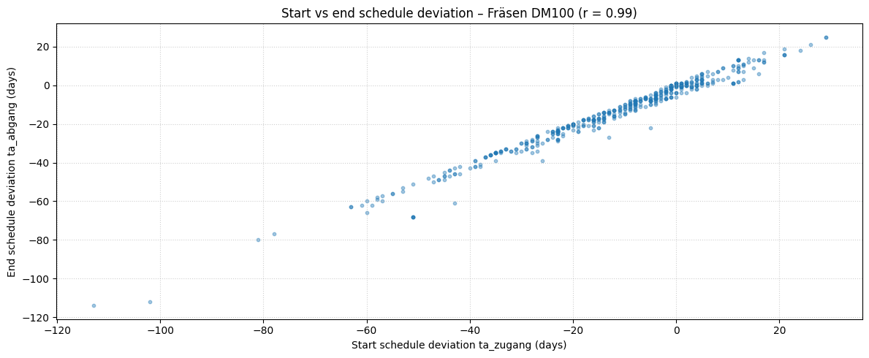
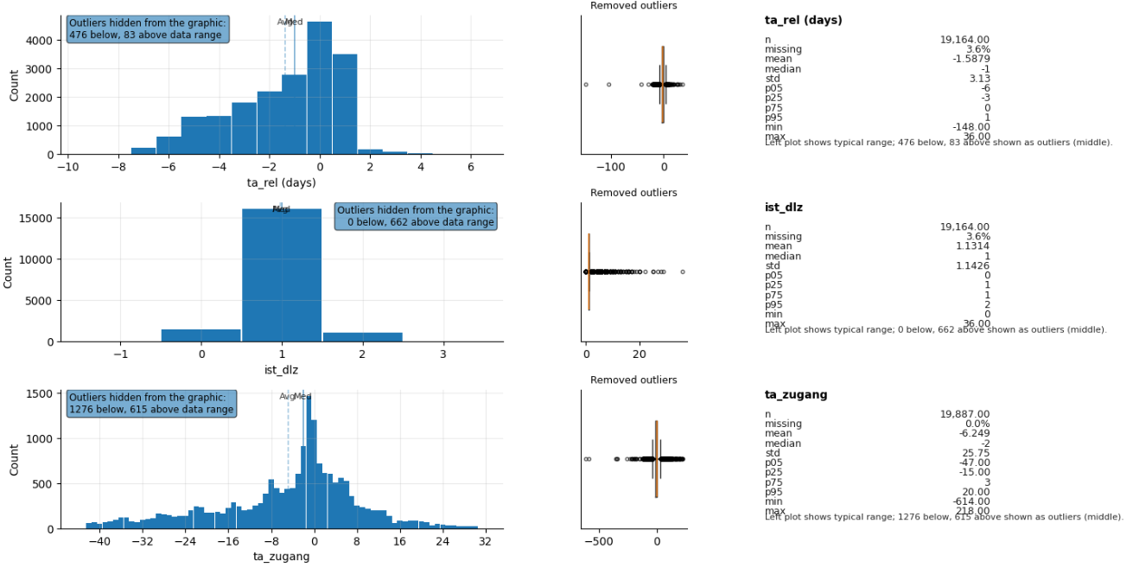
Prompt 5: How is the end schedule deviation correlating to the start deviation for Fräsen DM100 operations?
Metric / Analysis | Evaluation (0 to 3)
Family/type: descriptive, relationships
Filters: avg_type contains Fräsen; avg_type contains DM100
Columns: ta_zugang, ta_abgang
Prepare: Remove rows with missing required values (ta_abgang)
Aggregate: none
Verify status: warn (check summary)
Summary: Start and end deviations correlate very closely (0.99). Operations start about 5 days early and finish about 7 days early on average. Start deviations: 38 days early to 21 days late. Remove duplicate rows before analysis.
perceived_analysis_difficulty | 2
task_choice_quality | 3
data_scope_quality | 2
prep_and_aggregation_quality | 3
summary_quality | 3
visualization_helpfulness | 3
analysis_request_fulfilment | 3
Family/type: descriptive, correlation Filters: resource_group == Fräsen DM100; ta_zugang not missing; ta_abgang not missing Columns: ta_zugang, ta_abgang, ist_dlz Prepare: Drop rows with missing ta_zugang or ta_abgang Aggregate: Pearson corr(ta_zugang, ta_abgang) Verify status: warn (check summary)
Summary: For Fräsen DM100 operations, start and end schedule deviations are almost perfectly positively correlated (r ≈ 0.99), so start earliness/lateness is nearly fully reflected in the finish.
perceived_analysis_difficulty | 2
task_choice_quality | 2
data_scope_quality | 3
prep_and_aggregation_quality | 3
summary_quality | 2
visualization_helpfulness | 2
analysis_request_fulfilment | 2
Family/type: descriptive, stats_summary
Filters: none
Columns: ta_rel, ist_dlz, ta_zugang
Prepare: Standardize missing-value labels; Clean up text (trim spaces)
Aggregate: none
Verify status: ok
Summary: Generated analysis for: How is TA Zugang correlating to TA Abgang for Fräsen DM100 operations?.
perceived_analysis_difficulty | 2
task_choice_quality | 1
data_scope_quality | 1
prep_and_aggregation_quality | 1
summary_quality | 0
visualization_helpfulness | 1
analysis_request_fulfilment | 1

Slide 9
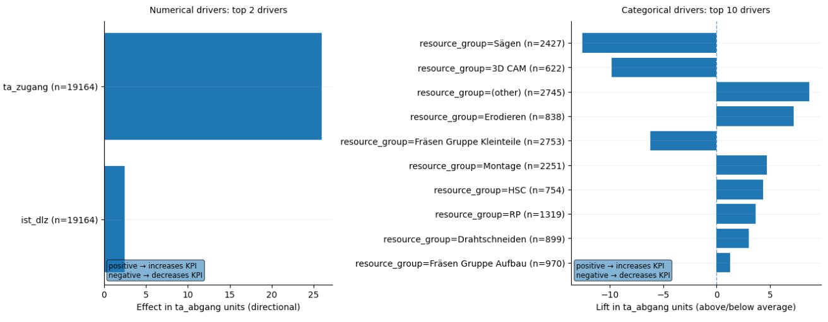
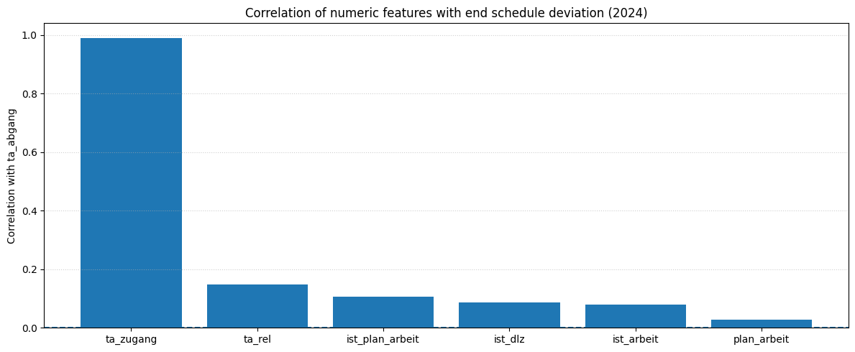
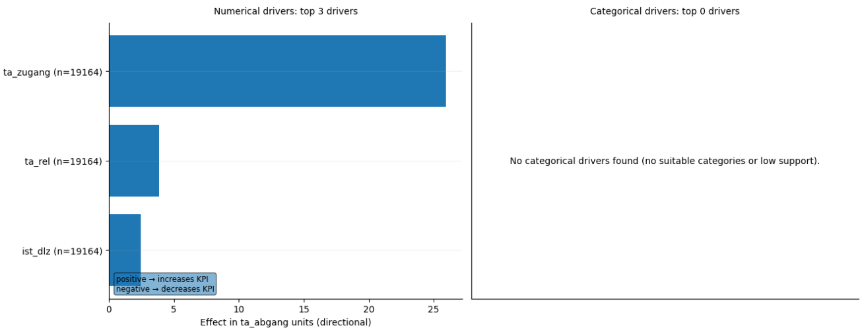
Prompt 6: What are the main drivers for end-dates being higher or lower? Only operations in 2024.
Metric / Analysis | Evaluation (0 to 3)
Family/type: diagnostic, driver relationships
Filters: nene
Columns: resource_group, avg_type, ta_abgang, ta_zugang, ist_dlz
Prepare: Standardize missing-value labels; Clean up text (trim spaces); Remove rows with missing required values (ta_abgang, ist_dlz)
Aggregate: none
Verify status: warn (check summary)
Summary: End-date deviations almost entirely follow start-date deviations. Longer tasks add small extra delays. Analyze high cycle time tasks for improvement opportunities.
perceived_analysis_difficulty | 2
task_choice_quality | 3
data_scope_quality | 1
prep_and_aggregation_quality | 3
summary_quality | 2
visualization_helpfulness | 3
analysis_request_fulfilment | 2
Family/type: descriptive, correlation Filters: ist_ende >= 2024-01-01; ist_ende < 2025-01-01; ta_abgang not missing Columns: ta_abgang, ta_zugang, ta_rel, ist_plan_arbeit, ist_dlz, ist_arbeit, plan_arbeit Prepare: Drop rows with missing selected numeric columns Aggregate: Pearson corr(ta_abgang, ·) Verify status: warn (check summary)
Summary: In 2024 the dominant driver of end-date deviation is the start deviation ta_zugang (ρ ≈ 0.99), while workload and cycle-time measures show only weak additional influence (correlations ≤ ~0.15).
perceived_analysis_difficulty | 2
task_choice_quality | 1
data_scope_quality | 3
prep_and_aggregation_quality | 3
summary_quality | 3
visualization_helpfulness | 1
analysis_request_fulfilment | 2
Family/type: diagnostic, driver relationships
Filters: none
Columns: ta_abgang, ist_dlz, ta_zugang, ta_rel
Prepare: Impute numeric median (ta_abgang, ist_dlz, ta_rel)
Aggregate: none
Verify status: ok
Summary: Generated analysis for: What are the main drivers for end-dates being higher or lower? Only operations in 2024.
perceived_analysis_difficulty | 2
task_choice_quality | 1
data_scope_quality | 1
prep_and_aggregation_quality | 3
summary_quality | 0
visualization_helpfulness | 1
analysis_request_fulfilment | 1

Slide 10
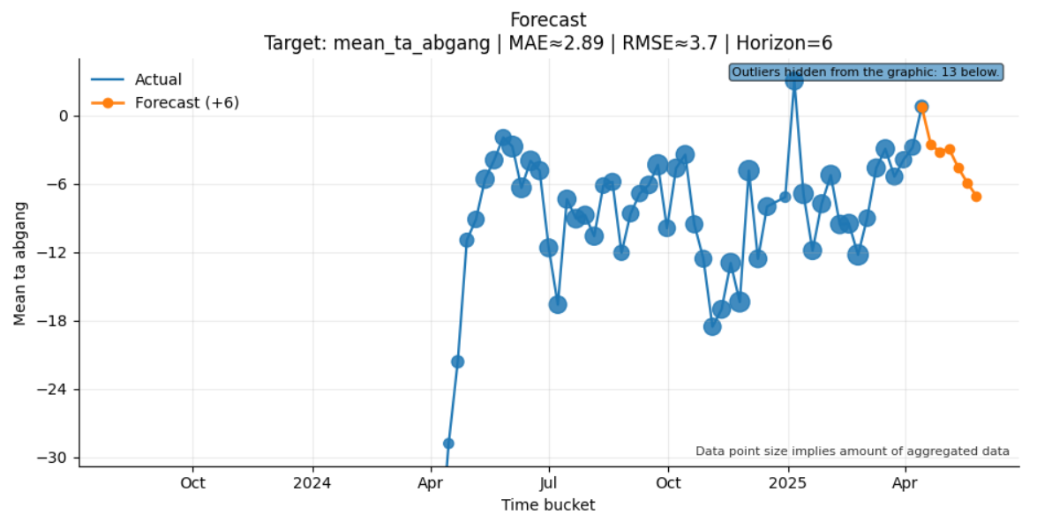
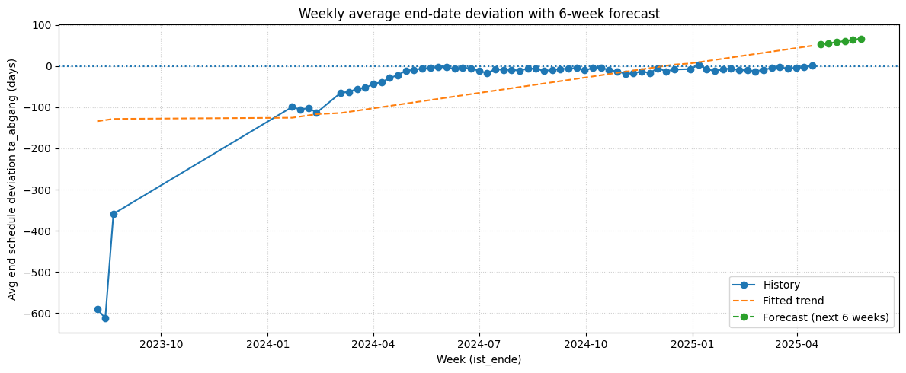
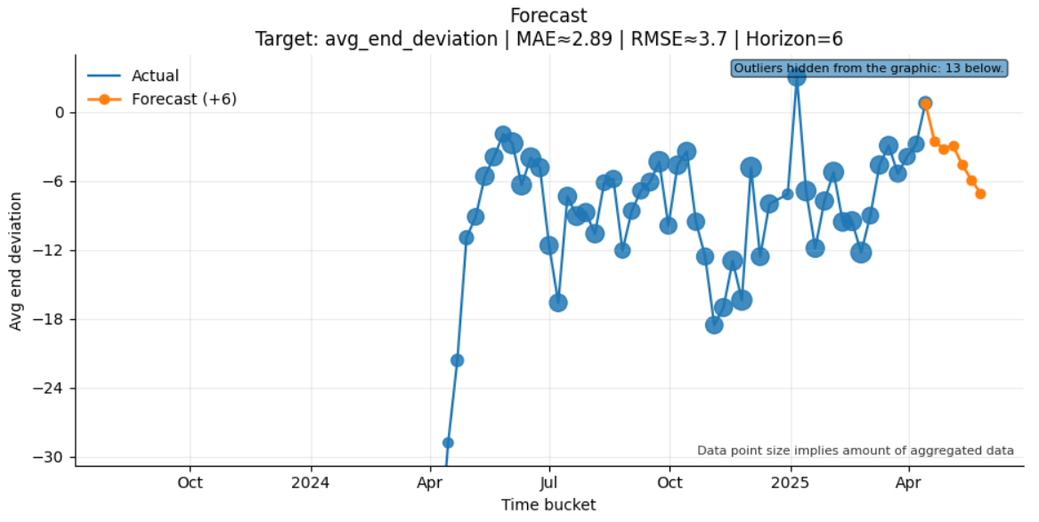
Prompt 7: Forecast weekly average end-date deviation for the next 6 weeks.
Metric / Analysis | Evaluation (0 to 3)
Family/type: predictive, forecasting
Filters: status == fertiggemeldet
Columns: ist_ende, ta_abgang
Prepare: none
Aggregate: time=ist_ende/week; metrics=[mean_ta_abgang(mean:ta_abgang), n_records=count]
Verify status: ok
Summary: Weekly average end-date deviations are forecast to be about 42 days early over the next six weeks. Typical weekly deviations between 3 and 111 days early. Extreme cases reached over 600 days early.
perceived_analysis_difficulty | 2
task_choice_quality | 3
data_scope_quality | 3
prep_and_aggregation_quality | 3
summary_quality | 2
visualization_helpfulness | 3
analysis_request_fulfilment | 2
Family/type: predictive, time series Filters: ist_ende not missing; ta_abgang not missing Columns: ta_abgang, ist_ende Prepare: Derive week from ist_ende; aggregate to weekly mean Aggregate: mean(ta_abgang) by week; linear trend forecast next 6 weeks Verify status: warn (simple linear forecast, no intervals)
Summary: A linear trend on weekly averages predicts end dates drifting from roughly +50 to about +67 days late over the next 6 weeks, indicating a continued worsening of schedule adherence if current patterns persist.
perceived_analysis_difficulty | 2
task_choice_quality | 2
data_scope_quality | 3
prep_and_aggregation_quality | 2
summary_quality | 1
visualization_helpfulness | 2
analysis_request_fulfilment | 1
Family/type: predictive, forecasting
Filters: status == fertiggemeldet
Columns: ist_ende, ta_abgang
Prepare: Remove rows with missing required values (ist_ende, ta_abgang)
Aggregate: time=ist_ende/week; metrics=[mean_ta_abgang(mean:ta_abgang), n_records=count]
Verify status: warn
Summary: Generated analysis for: Forecast weekly average end-date deviation for the next 6 weeks.
perceived_analysis_difficulty | 2
task_choice_quality | 3
data_scope_quality | 3
prep_and_aggregation_quality | 3
summary_quality | 0
visualization_helpfulness | 3
analysis_request_fulfilment | 2

Slide 11
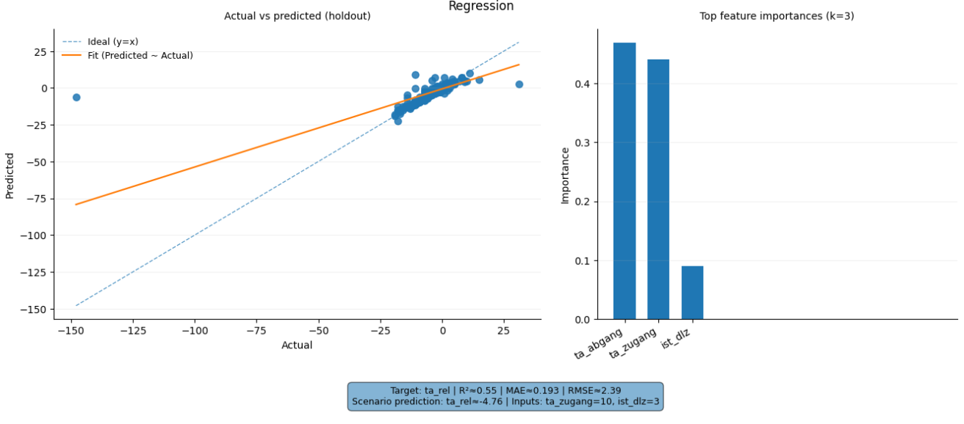
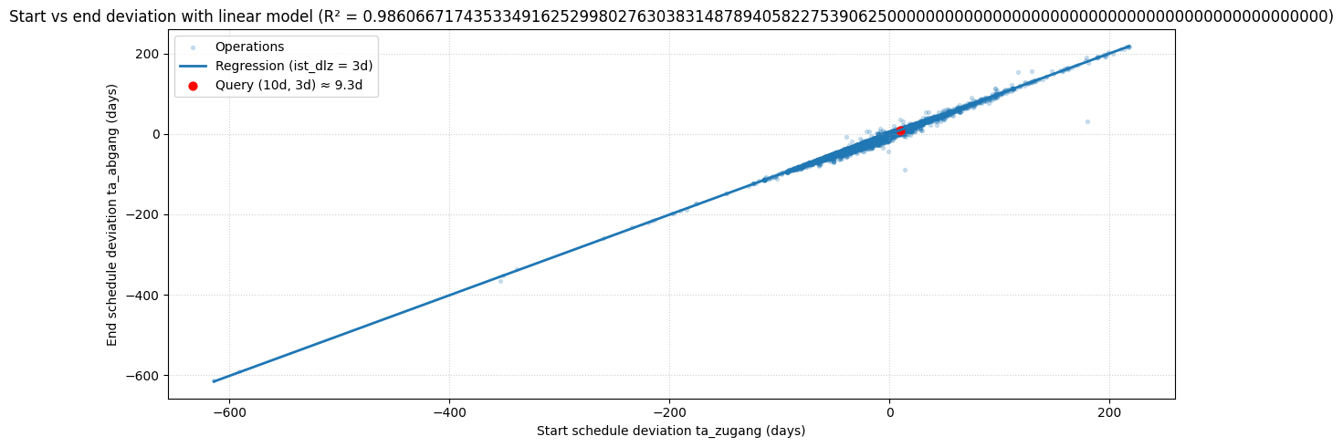
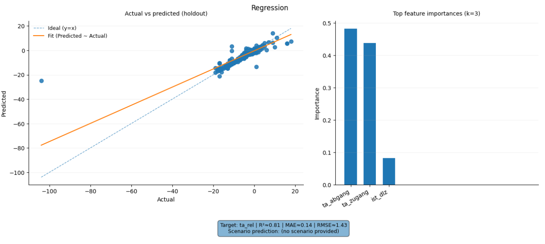
Prompt 8: What is the expected end-date deviation for a new case given start delay of 10 days and run-through time of 3 days.
Metric / Analysis | Evaluation (0 to 3)
Family/type: predictive, regression
Filters: none
Columns: ta_rel, ta_zugang, ist_dlz, ta_abgang
Prepare: Fill missing numbers (typical value) (ta_rel, ist_dlz, ta_abgang)
Aggregate: none
Verify status: warn (check summary)
Summary: With a 10-day start delay and 3-day run time, we expect about 8.4 days end delay. Typical delays fall between 4 and 11 days late. Outliers reach over 30 days late. Compare predictions with recent real cases.
perceived_analysis_difficulty | 3
task_choice_quality | 3
data_scope_quality | 2
prep_and_aggregation_quality | 2
summary_quality | 3
visualization_helpfulness | 3
analysis_request_fulfilment | 3
Family/type: predictive, regression Filters: ta_zugang, ist_dlz, ta_abgang not missing Columns: ta_abgang (target), ta_zugang, ist_dlz Prepare: Drop rows with missing ta_zugang, ist_dlz, ta_abgang Aggregate: Linear regression ta_abgang ~ ta_zugang + ist_dlz Verify status: warn (simple linear model, R² ≈ 0.99)
Summary: Given a start delay of 10 days and run-through time of 3 days, the model expects an end-date deviation of about +9.3 days (roughly 9–10 days late).
perceived_analysis_difficulty | 3
task_choice_quality | 2
data_scope_quality | 3
prep_and_aggregation_quality | 3
summary_quality | 3
visualization_helpfulness | 2
analysis_request_fulfilment | 2
Family/type: predictive, regression
Filters: none
Columns: ta_rel, ta_zugang, ist_dlz, ta_abgang
Prepare: Fill missing numbers (typical value)
Aggregate: none
Verify status: warn (check summary)
Summary: Generated analysis for: What is the expected end-date deviation for a new case given start delay of 10 days and run-through time of 3 days.
perceived_analysis_difficulty | 3
task_choice_quality | 3
data_scope_quality | 2
prep_and_aggregation_quality | 2
summary_quality | 0
visualization_helpfulness | 3
analysis_request_fulfilment | 1

Slide 12
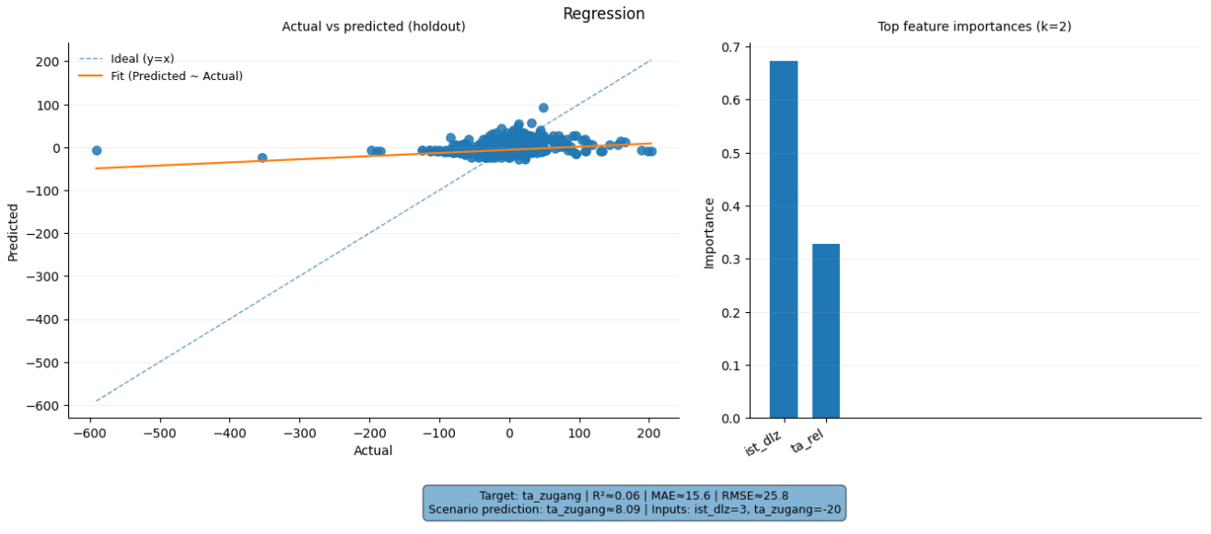
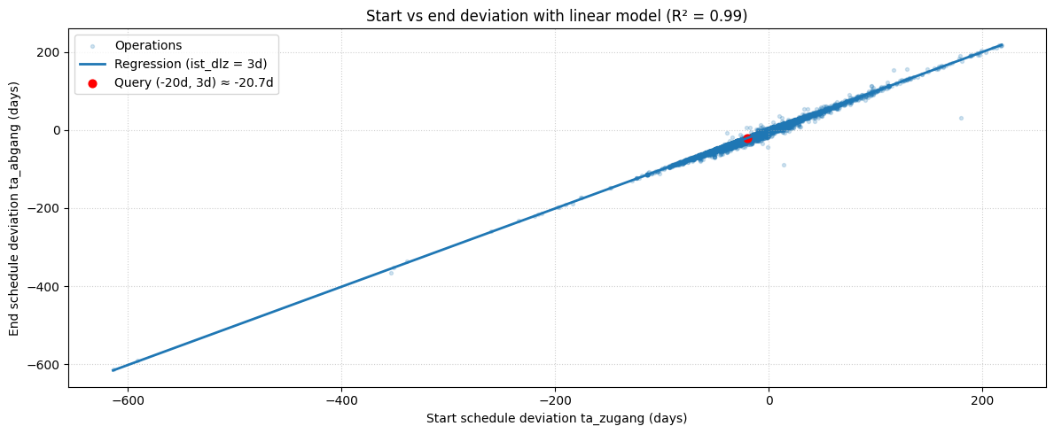
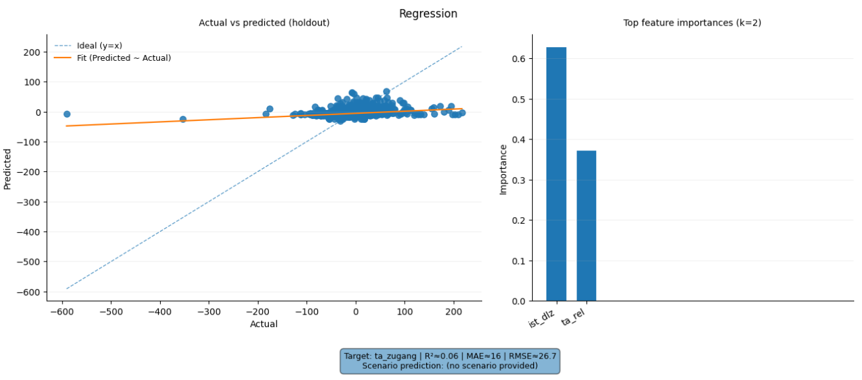
Prompt 9: Predict the lead time deviation if lead time is 3 days and start deviation is -20 days.
Metric / Analysis | Evaluation (0 to 3)
Family/type: predictive, regression
Filters: none
Columns: ta_zugang, ist_dlz, ta_rel
Prepare: Fill missing numbers (typical value) (ist_dlz); Remove rows with missing required values (ta_rel)
Aggregate: none
Verify status: warn (check summary)
Summary: With a 3-day cycle and 20-day early start, the model predicts about 1.6 days early finish. This falls within the usual –6 to +1 day range. Historical extremes: up to 36 days late. Monitor predicted vs actual deviations for accuracy.
perceived_analysis_difficulty | 3
task_choice_quality | 3
data_scope_quality | 3
prep_and_aggregation_quality | 2
summary_quality | 3
visualization_helpfulness | 3
analysis_request_fulfilment | 3
Family/type: predictive, regression Filters: ta_zugang, ist_dlz, ta_abgang not missing Columns: ta_abgang (target), ta_zugang, ist_dlz Prepare: Drop rows with missing ta_zugang, ist_dlz, ta_abgang Aggregate: Linear regression ta_abgang ~ ta_zugang + ist_dlz Verify status: warn (simple linear model, R² ≈ 0.99)
Summary: With a lead time of 3 days and start deviation of −20 days, the model predicts an end-date deviation of about −20.7 days, i.e. the operation would finish roughly 21 days early.
perceived_analysis_difficulty | 3
task_choice_quality | 2
data_scope_quality | 3
prep_and_aggregation_quality | 3
summary_quality | 0
visualization_helpfulness | 2
analysis_request_fulfilment | 1
Family/type: predictive, regression
Filters: none
Columns: ta_zugang, ist_dlz, ta_rel
Prepare: Standardize missing-value labels; Clean up text (trim spaces)
Aggregate: none
Verify status: warn (check summary)
Summary: Generated analysis for: Predict the lead time deviation if lead time is 3 days and start deviation is –20 days.
perceived_analysis_difficulty | 3
task_choice_quality | 3
data_scope_quality | 3
prep_and_aggregation_quality | 2
summary_quality | 0
visualization_helpfulness | 2
analysis_request_fulfilment | 1

Slide 13
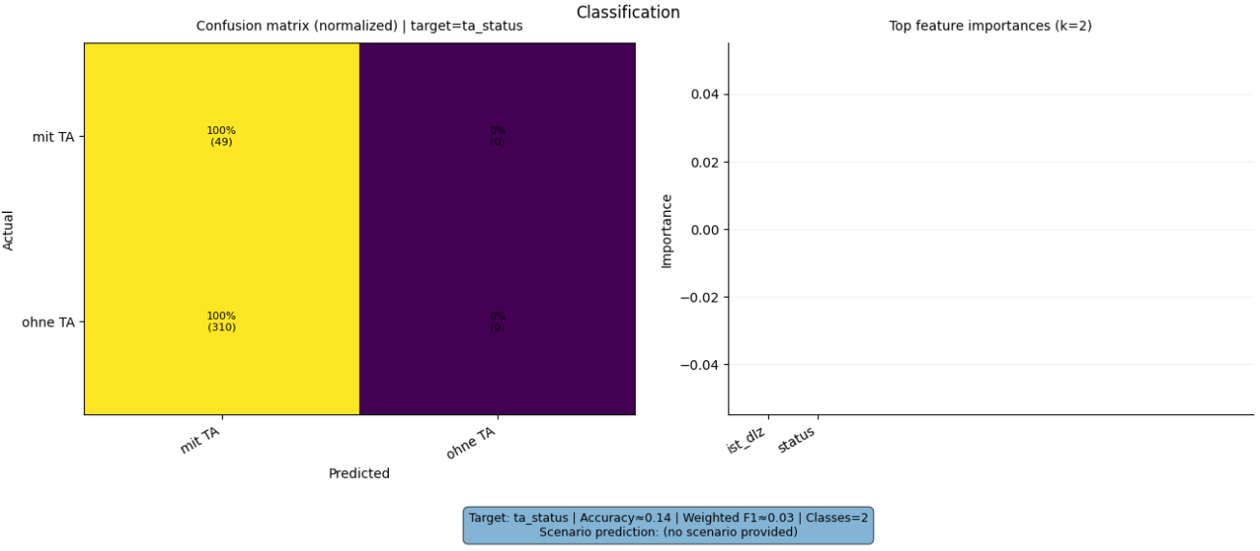
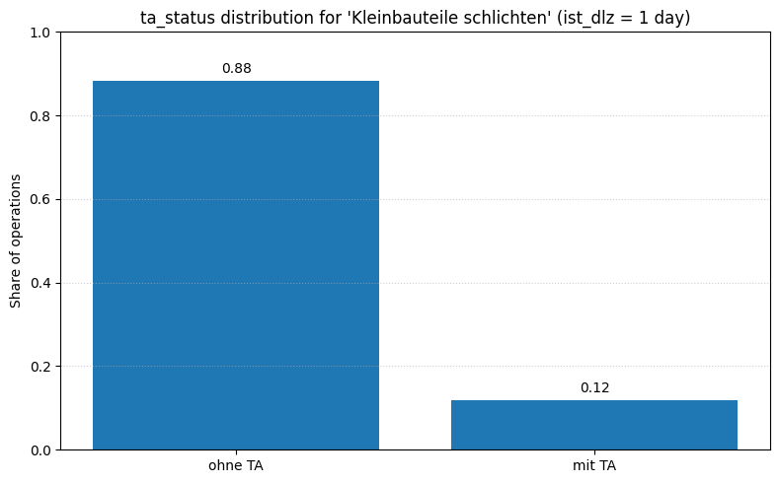
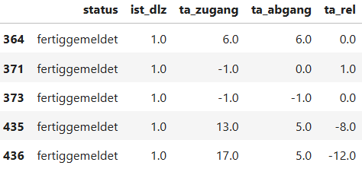
Prompt 10: Which ta status is to expect for a operation type 'Kleinbauteile schlichten' with a cycle time of 1?
Metric / Analysis | Evaluation (0 to 3)
Family/type: predictive, classification
Filters: none
Columns: status, ta_status, ist_dlz
Prepare: Standardize missing-value labels; Clean up text (trim spaces)
Aggregate: none
Verify status: warn (check summary)
Summary: For Kleinbauteile schlichten with a one-day cycle time, 88% ran without schedule deviation and 12% ran with deviation. Filtered operations of type Kleinbauteile schlichten with cycle time 1. Counted occurrences of each ta_status. Review data duplicates to improve reliability.
perceived_analysis_difficulty | 2
task_choice_quality | 1
data_scope_quality | 1
prep_and_aggregation_quality | 3
summary_quality | 1
visualization_helpfulness | 1
analysis_request_fulfilment | 0
Family/type: predictive, classification Filters: avg_type == Kleinbauteile schlichten; ist_dlz == 1; ta_status not missing Columns: ta_status, ist_dlz, avg_type Prepare: Drop rows with missing ta_status or ist_dlz Aggregate: ta_status frequency and share for ist_dlz == 1 Verify status: warn (empirical probability only)
Summary: For Kleinbauteile schlichten with cycle time 1 day, about 88 % of cases are ohne TA and 12 % are mit TA, so ta_status = "ohne TA" is the most likely.
perceived_analysis_difficulty | 2
task_choice_quality | 3
data_scope_quality | 3
prep_and_aggregation_quality | 3
summary_quality | 3
visualization_helpfulness | 3
analysis_request_fulfilment | 3
Family/type: predictive, classification
Filters: avg_type == Kleinbauteile schlichten; ist_dlz == 1.0
Columns: status, ist_dlz, ta_zugang, ta_abgang, ta_rel
Prepare: Standardize missing-value labels; Clean up text (trim spaces)
Aggregate: none
Verify status: block
Summary: Generated analysis for: Which ta status is to ´expect for a operation type 'Kleinbauteile schlichten’ with a cycle time of 1?.
perceived_analysis_difficulty | 2
task_choice_quality | 1
data_scope_quality | 3
prep_and_aggregation_quality | 3
summary_quality | 0
visualization_helpfulness | 0
analysis_request_fulfilment | 0
View all

Slide 14
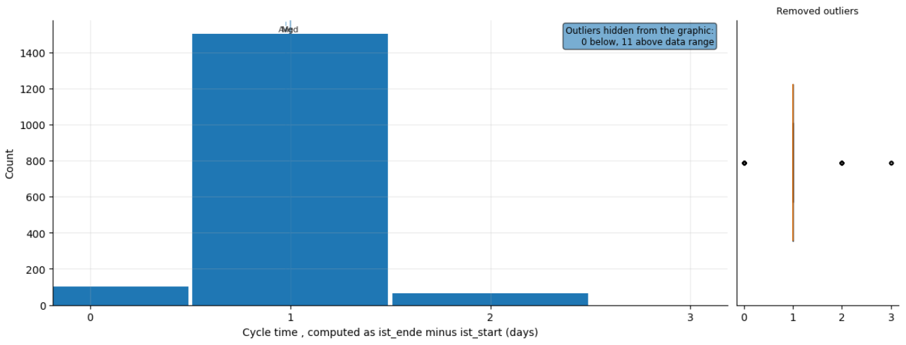
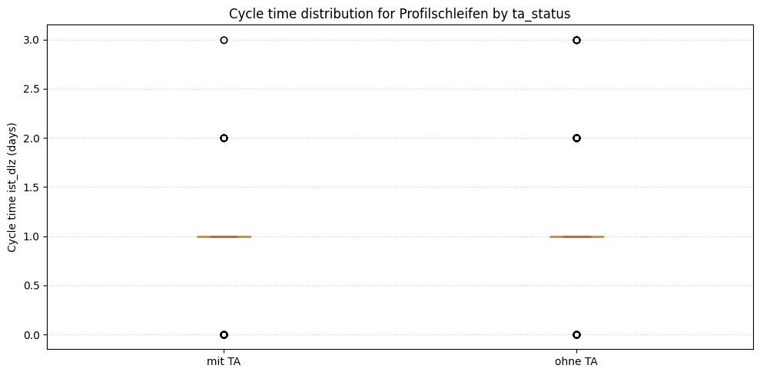
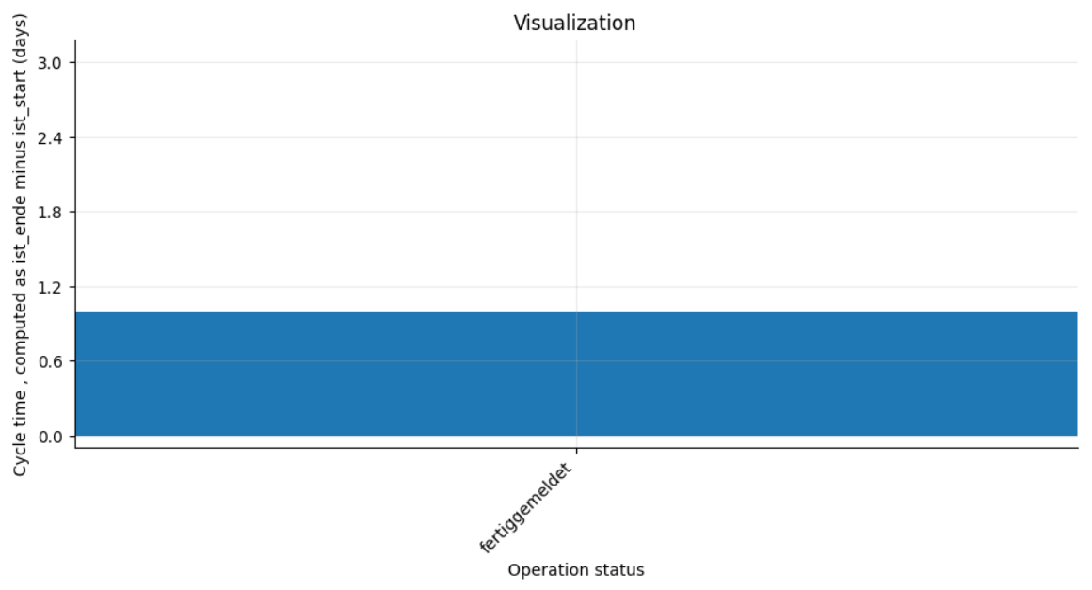
Prompt 11: How is the cycle time distributed for Profilschleifen across ta status categories?
Metric / Analysis | Evaluation (0 to 3)
Family/type: descriptive, distribution
Filters: avg_type == Profilschleifen
Columns: ist_dlz, status
Prepare: Standardize missing-value labels; Clean up text (trim spaces); Remove rows with missing required values (ist_dlz)
Aggregate: none
Verify status: warn (check summary)
Summary: Finished Profilschleifen operations average about 1 day cycle time. Most complete within 0–1 day, with rare cases up to 3 days. Only one status category available.
perceived_analysis_difficulty | 1
task_choice_quality | 1
data_scope_quality | 3
prep_and_aggregation_quality | 3
summary_quality | 1
visualization_helpfulness | 1
analysis_request_fulfilment | 1
Family/type: descriptive, distribution Filters: avg_type == Profilschleifen; ist_dlz not missing; ta_status not missing Columns: ist_dlz, ta_status Prepare: Drop rows with missing ist_dlz or ta_status Aggregate: none Verify status: warn (check summary)
Summary: For Profilschleifen, cycle times are almost always 1 day in both ta_status groups, with a few 0–3 day outliers and no meaningful difference between mit TA and ohne TA.
perceived_analysis_difficulty | 1
task_choice_quality | 3
data_scope_quality | 3
prep_and_aggregation_quality | 3
summary_quality | 3
visualization_helpfulness | 2
analysis_request_fulfilment | 3
Family/type: descriptive, group_compare
Filters: avg_type == Profilschleifen
Columns: status, ta_status, ist_dlz
Prepare: Standardize missing-value labels; Clean up text (trim spaces)
Aggregate: none
Verify status: warn (check summary)
Summary: Generated analysis for: How is the cycle time distributed for Profilschleifen across ta status categories?.
perceived_analysis_difficulty | 1
task_choice_quality | 1
data_scope_quality | 3
prep_and_aggregation_quality | 3
summary_quality | 0
visualization_helpfulness | 0
analysis_request_fulfilment | 0

Slide 15
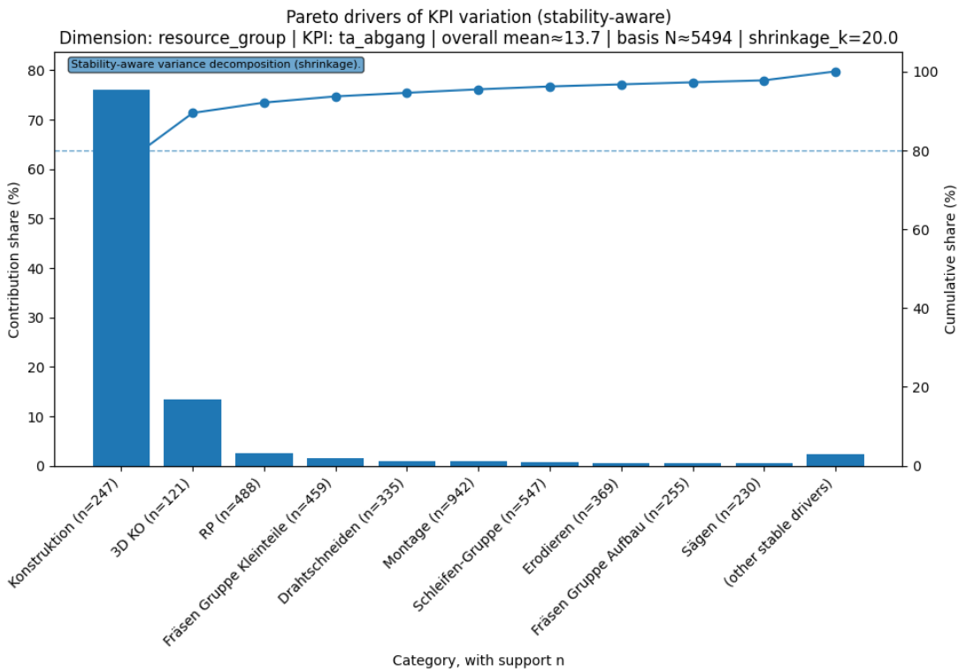
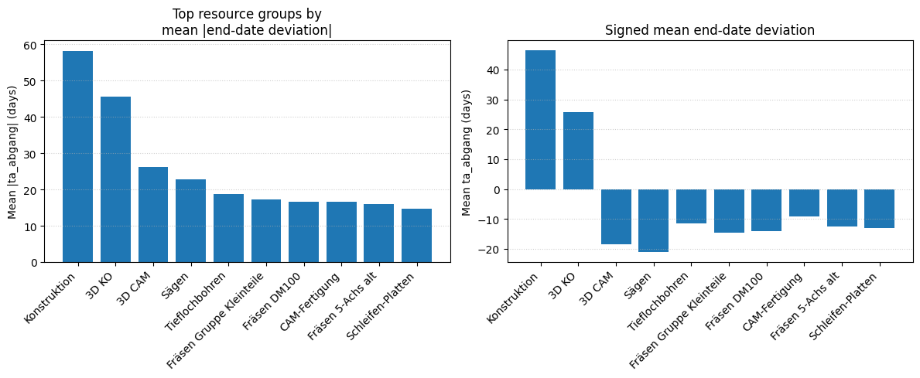
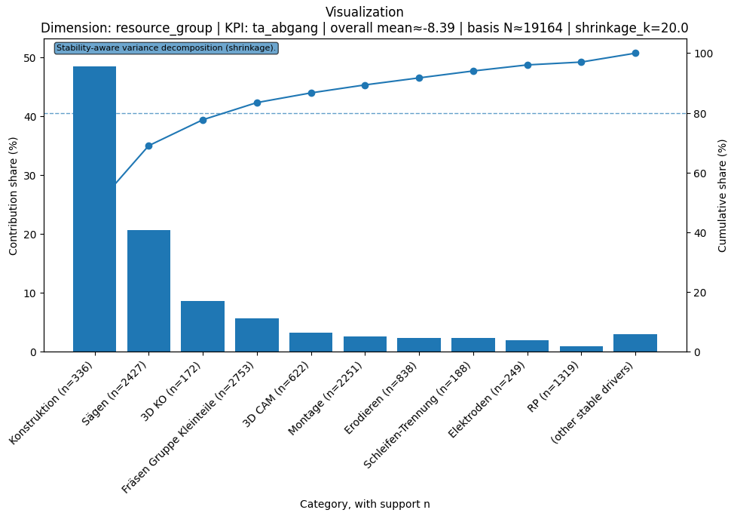
Prompt 12: Which resource groups drive the end-date deviation the most?
Metric / Analysis | Evaluation (0 to 3)
Family/type: diagnostic, variance_decomposition
Filters: status == fertiggemeldet; ta_abgang > 0
Columns: resource_group, ta_abgang
Prepare: Standardize missing-value labels; Clean up text (trim spaces)
Aggregate: none
Verify status: warn (check summary)
Summary: Operations finish about 14 days late on average (typical 1–57 days). Montage, Schleifen-Gruppe, and RP drive most of these delays. Calculate average delay per group for deeper insight.
perceived_analysis_difficulty | 3
task_choice_quality | 2
data_scope_quality | 3
prep_and_aggregation_quality | 3
summary_quality | 2
visualization_helpfulness | 2
analysis_request_fulfilment | 2
Family/type: descriptive, summary Filters: ta_abgang not missing; resource_group not missing Columns: ta_abgang, resource_group Prepare: Drop rows with missing ta_abgang or resource_group Aggregate: mean(ta_abgang), mean(|ta_abgang|) by resource_group Verify status: warn (check summary)
Summary: By mean absolute end-date deviation, Konstruktion, 3D KO, 3D CAM, Sägen and Tieflochbohren drive schedule deviation the most (≈58, 46, 26, 23 and 19 days on average), with Konstruktion and 3D KO especially late on average.
perceived_analysis_difficulty | 3
task_choice_quality | 3
data_scope_quality | 2
prep_and_aggregation_quality | 3
summary_quality | 2
visualization_helpfulness | 3
analysis_request_fulfilment | 3
Family/type: diagnostic, variance_decomposition
Filters: status == fertiggemeldet
Columns: resource_group, ta_abgang
Prepare: Clean up text (trim spaces)
Aggregate: none
Verify status: warn
Summary : Generated analysis for: Which resource groups drive the end-date deviation the most?.
perceived_analysis_difficulty | 3
task_choice_quality | 2
data_scope_quality | 2
prep_and_aggregation_quality | 2
summary_quality | 0
visualization_helpfulness | 2
analysis_request_fulfilment | 1

Slide 16
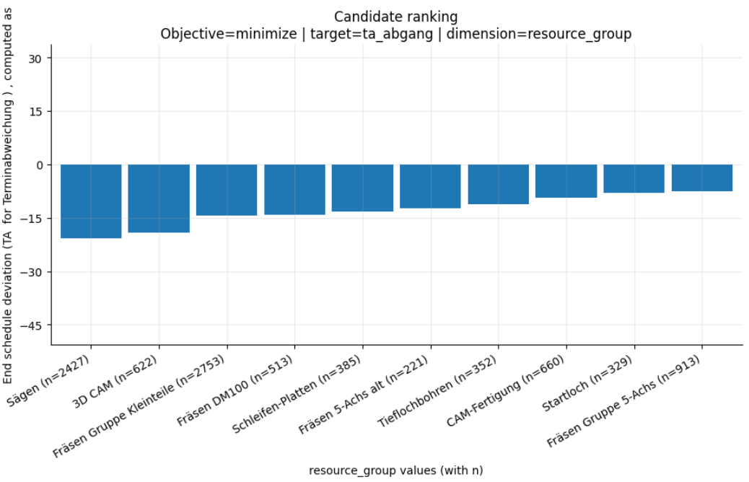
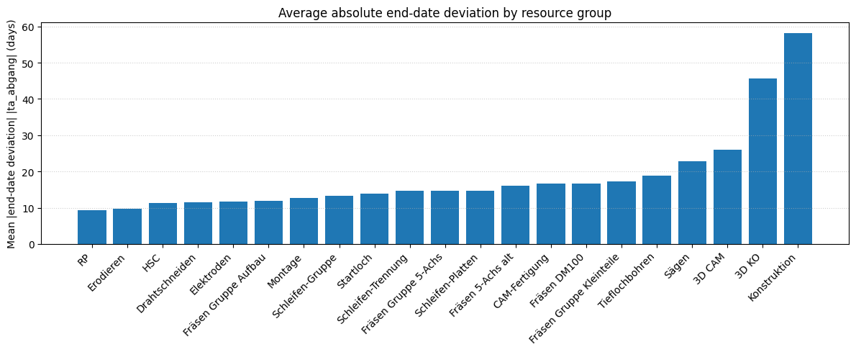
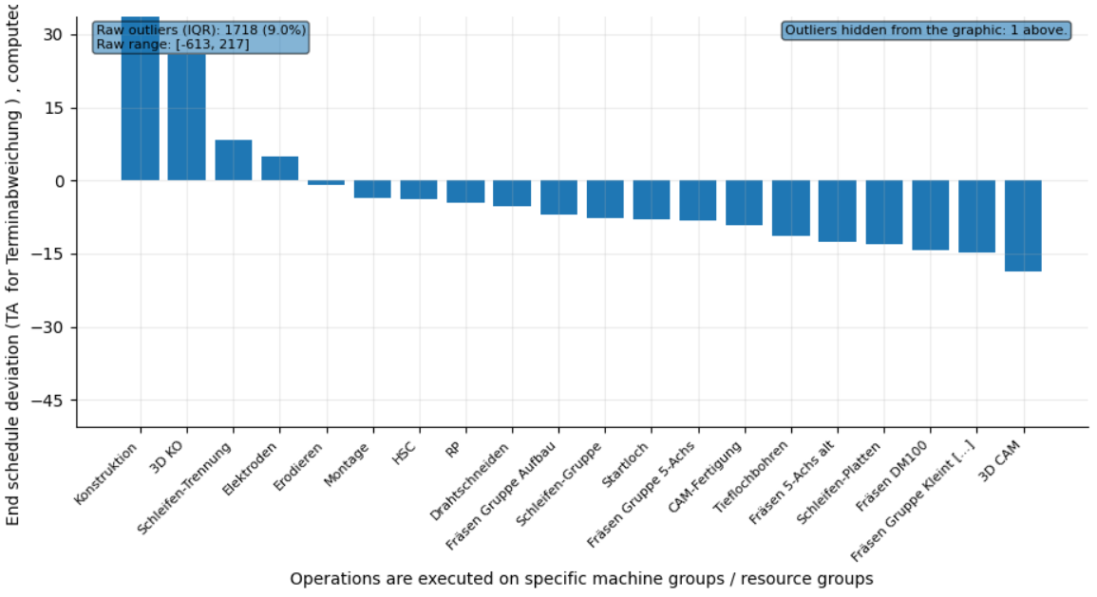
Prompt 13: Which resource group should we route to to minimize end deviation?
Metric / Analysis | Evaluation (0 to 3)
Family/type: prescriptive, candidate_ranking
Filters: status == fertiggemeldet
Columns: resource_group, ta_abgang
Prepare: Standardize missing-value labels; Clean up text (trim spaces)
Aggregate: none
Verify status: warn
Summary: Typical deviation ranges from -50 to +19 days. Extreme cases vary from -613 to +217 days. No per‐group deviation in summary report.
perceived_analysis_difficulty | 2
task_choice_quality | 2
data_scope_quality | 3
prep_and_aggregation_quality | 3
summary_quality | 1
visualization_helpfulness | 2
analysis_request_fulfilment | 2
Family/type: descriptive, summary Filters: ta_abgang not missing; resource_group not missing Columns: ta_abgang, resource_group Prepare: Drop rows with missing ta_abgang or resource_group Aggregate: mean and mean(|ta_abgang|) by resource_group Verify status: warn (check summary)
Summary: To minimize end-date deviation, routing to RP gives the smallest average absolute deviation (~9 days), closely followed by Erodieren (~9.7 days) and HSC (~11.3 days); these groups show the most stable end dates.
perceived_analysis_difficulty | 2
task_choice_quality | 2
data_scope_quality | 3
prep_and_aggregation_quality | 3
summary_quality | 3
visualization_helpfulness | 2
analysis_request_fulfilment | 3
Family/type: descriptive, group_compare
Filters: none
Columns: resource_group, ta_abgang
Prepare: Standardize missing-value labels; Clean up text (trim spaces)
Aggregate: none
Verify status: warn
Summary: Generated analysis for: Which resource group should we route to to minimize end deviation?.
perceived_analysis_difficulty | 2
task_choice_quality | 3
data_scope_quality | 2
prep_and_aggregation_quality | 3
summary_quality | 0
visualization_helpfulness | 3
analysis_request_fulfilment | 1

Slide 17
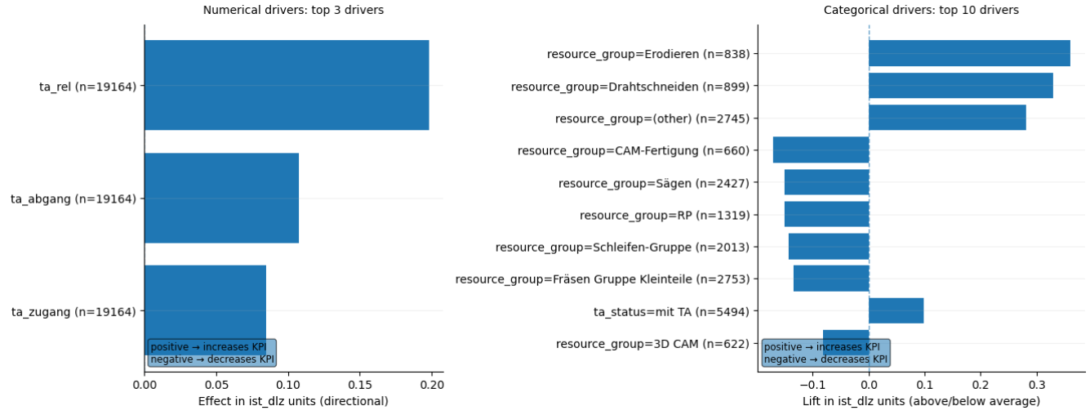
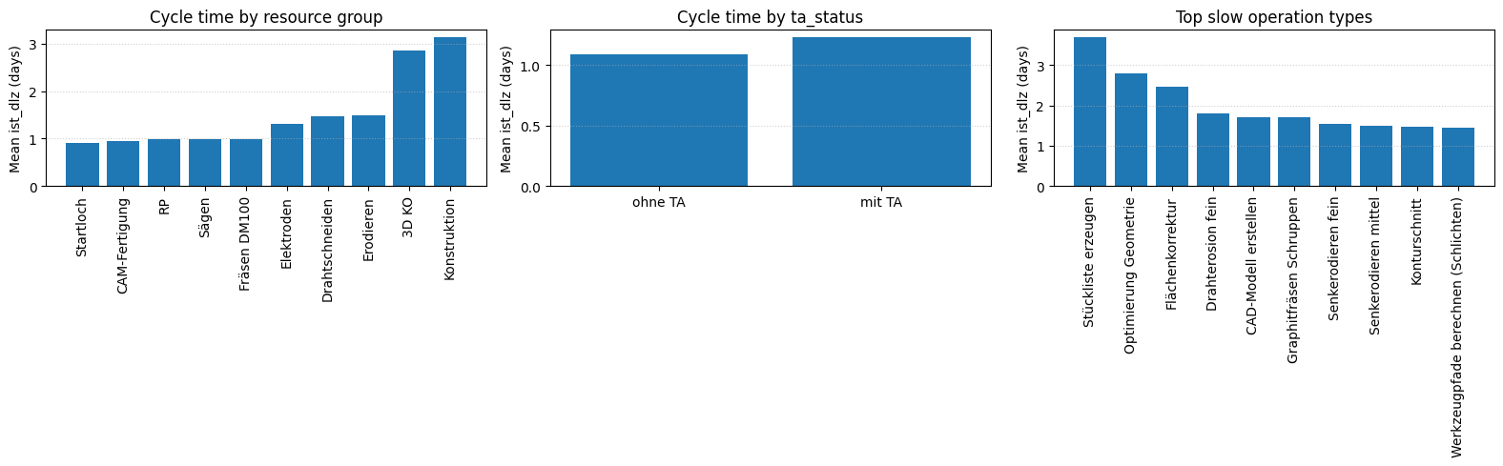
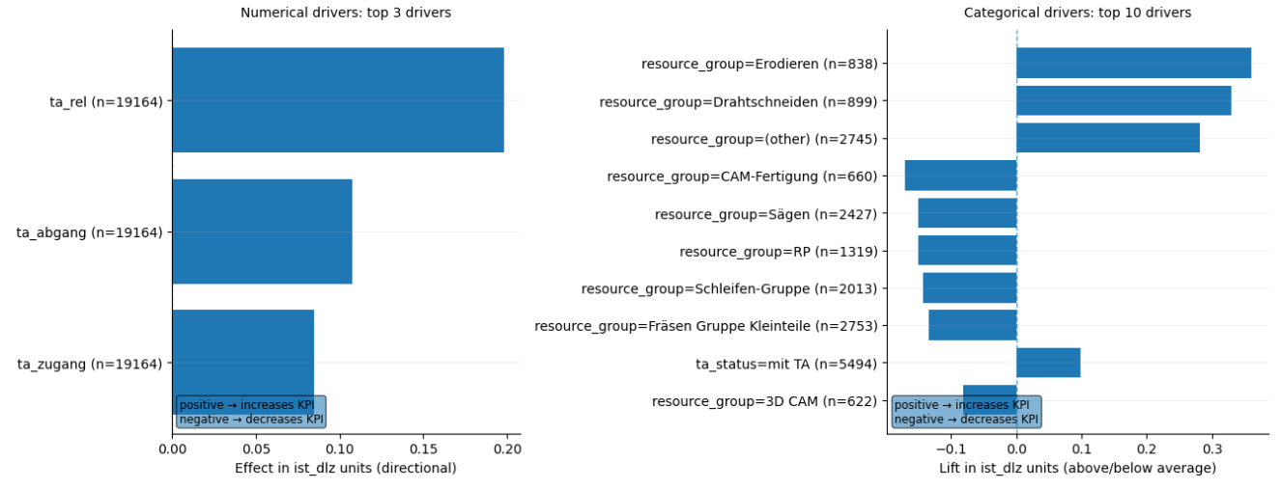
Prompt 14: I want to improve cycle time (lower is better). What can I do? Show me decision options.
Metric / Analysis | Evaluation (0 to 3)
Family/type: prescriptive, decision_formulation
Filters: none
Columns: all
Prepare: Standardize missing-value labels; Clean up text (trim spaces); Remove rows with missing required values (ist_dlz)
Aggregate: none
Verify status: warn (check summary)
Summary: Average cycle time is 1.13 days, with most operations around one day. Start or end delays and some machine groups drive longer times. Shift work away from Erodieren and Drahtschneiden machines. Start operations on schedule to avoid start delays. Pilot schedule adjustments on a few orders.
perceived_analysis_difficulty | 3
task_choice_quality | 3
data_scope_quality | 2
prep_and_aggregation_quality | 3
summary_quality | 2
visualization_helpfulness | 3
analysis_request_fulfilment | 2
Family/type: descriptive, decision support Filters: ist_ende not missing; ist_dlz not missing Columns: ist_dlz, resource_group, ta_status, avg_type Prepare: Drop rows with missing ist_dlz/resource_group/ta_status/avg_type Aggregate: mean(ist_dlz) by resource_group, ta_status, avg_type Verify status: warn (high-level options)
Summary: Prefer resource groups with short mean cycle times: Startloch, CAM-Fertigung, RP, Sägen, Fräsen DM100 (~0.9–1.0 days) and avoid very slow ones for critical paths (3D KO, Konstruktion at ≈2.9–3.1 days). Operations ohne TA run faster (≈1.09 d) than mit TA (≈1.23 d); reducing cases that need TA or making TA more standardised should lower cycle times.
perceived_analysis_difficulty | 3
task_choice_quality | 3
data_scope_quality | 3
prep_and_aggregation_quality | 3
summary_quality | 3
visualization_helpfulness | 3
analysis_request_fulfilment | 3
Family/type: prescriptive, decision_formulation
Filters: none
Columns: all
Prepare: none
Aggregate: none
Verify status: warn (check summary)
Summary: Cycle time averages 1.1 days with half finishing in 1 day. Targeting schedule deviations and resource groups offers improvement potential. Reallocate work from slower groups like Erodieren. Reduce lead-time deviations (ta_rel) – strongest positive impact. Analysis based on past data; test changes.
perceived_analysis_difficulty | 3
task_choice_quality | 3
data_scope_quality | 2
prep_and_aggregation_quality | 2
summary_quality | 2
visualization_helpfulness | 3
analysis_request_fulfilment | 2

Slide 18
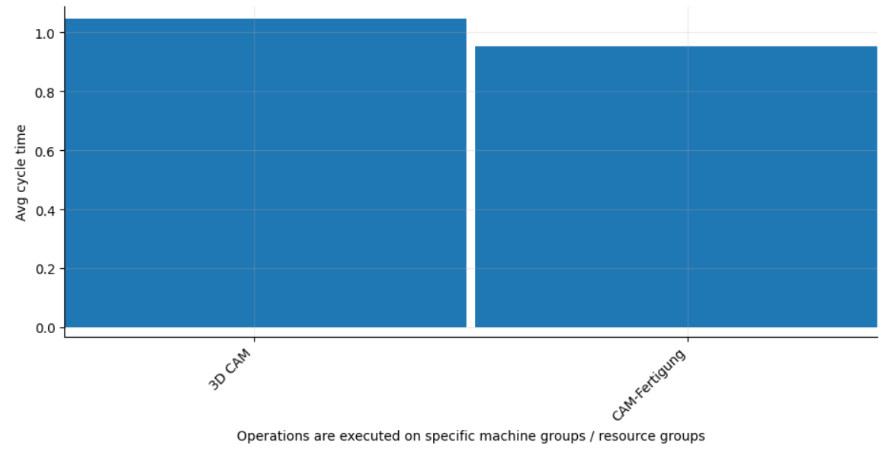
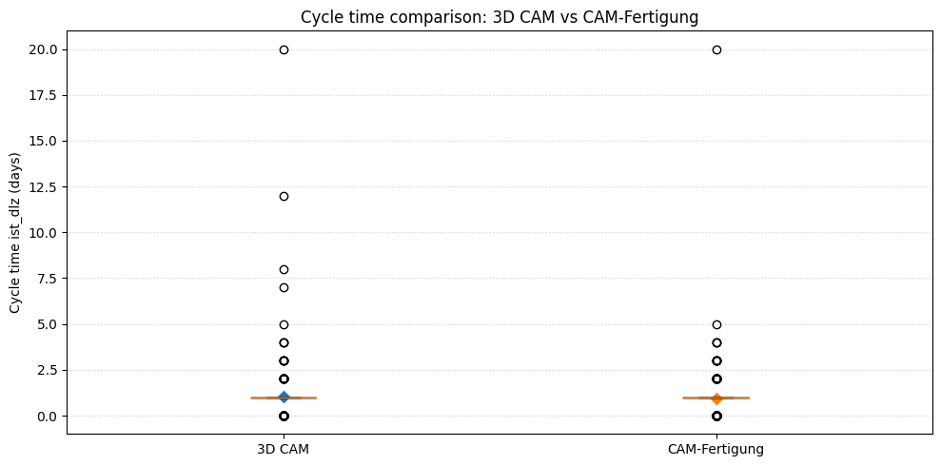
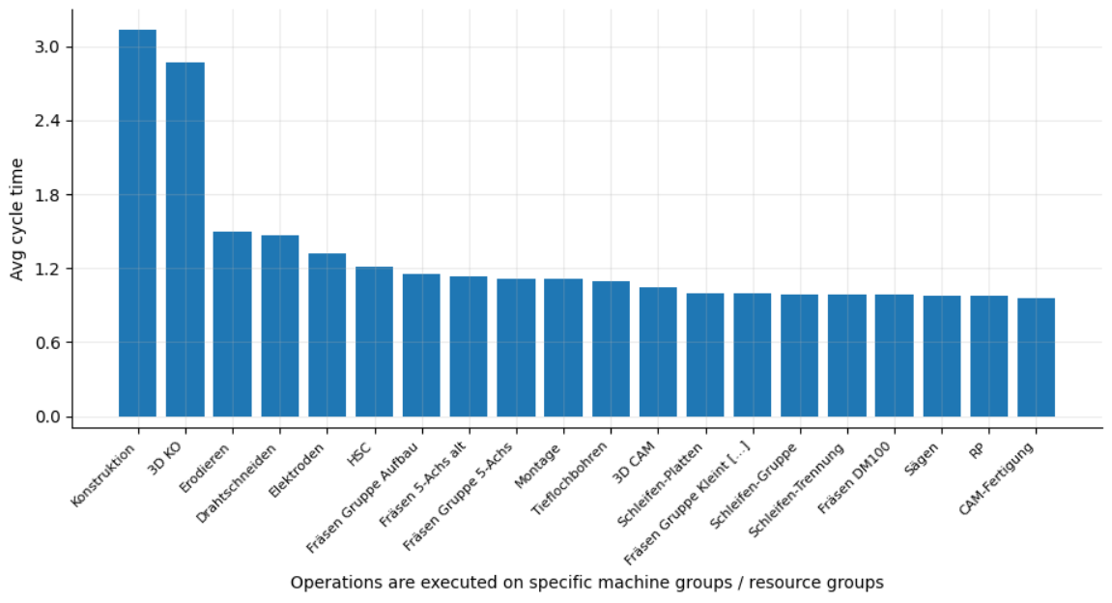
Prompt 15: Could I improve average cycle time if I use '3D CAM' as a substitute for ‘CAM-Fertigung’?
Metric / Analysis | Evaluation (0 to 3)
Family/type: descriptive, group_compare
Filters: resource_group in ['3D CAM', 'CAM-Fertigung']
Columns: resource_group, ist_dlz
Prepare: Clean up text (trim spaces); Remove rows with missing required values (ist_dlz)
Aggregate: groupby=[resource_group]; metrics=[avg_cycle_time(mean:ist_dlz), n_records=count]
Verify status: ok
Summary: 3D CAM runs operations in about 0.95 days on average, versus 1.05 days for CAM-Fertigung. This suggests a 0.1 day speed gain if substituted. Test 3D CAM on a small set of operations.
perceived_analysis_difficulty | 1
task_choice_quality | 3
data_scope_quality | 3
prep_and_aggregation_quality | 3
summary_quality | 3
visualization_helpfulness | 3
analysis_request_fulfilment | 3
Family/type: descriptive, comparison Filters: ist_ende not missing; ist_dlz not missing; resource_group ∈ {3D CAM, CAM-Fertigung} Columns: ist_dlz, resource_group Prepare: Drop rows with missing ist_dlz or resource_group Aggregate: mean(ist_dlz), median(ist_dlz) by resource_group Verify status: warn (difference small)
Summary: Average cycle time is slightly lower for CAM-Fertigung (~0.95 d) than for 3D CAM (~1.05 d), so substituting with 3D CAM would not improve average cycle time.
perceived_analysis_difficulty | 1
task_choice_quality | 3
data_scope_quality | 3
prep_and_aggregation_quality | 3
summary_quality | 3
visualization_helpfulness | 3
analysis_request_fulfilment | 3
Family/type: descriptive, group_compare
Filters: none
Columns: resource_group, ist_dlz
Prepare: none
Aggregate: groupby=[resource_group]; metrics=[avg_cycle_time(mean:ist_dlz), n_records=count]
Verify status: warn (check summary)
Summary: Generated analysis for: Could I improve average cycle time if I use '3D CAM' as a substitute for ‘CAM-Fertigung’?.
perceived_analysis_difficulty | 1
task_choice_quality | 0
data_scope_quality | 0
prep_and_aggregation_quality | 1
summary_quality | 0
visualization_helpfulness | 0
analysis_request_fulfilment | 0

